Slide 1
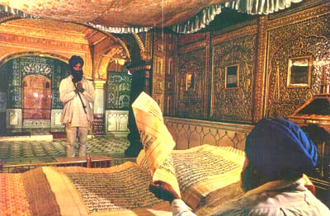
WHY IS THE TENTH GURU’S BANI NOT IN GURU GRANTH SAHIB?

Slide 2
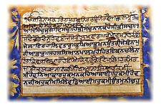
"Why is the bani of Guru Gobind Singh not included in the Guru Granth Sahib?"
Grammar and language is the main reason.
Gurbani in the Guru Granth Sahib has no letters with foot dots. (S, z)
With the evolution of the language, foot dots were added at the bottom of five letters to assign them the sound of Persian letters, non-existent in Panjabi.
Another symbol called adhik which doubles the sound of the letter on the top of which it is placed, had also evolved by the time of the tenth Guru.

Slide 3
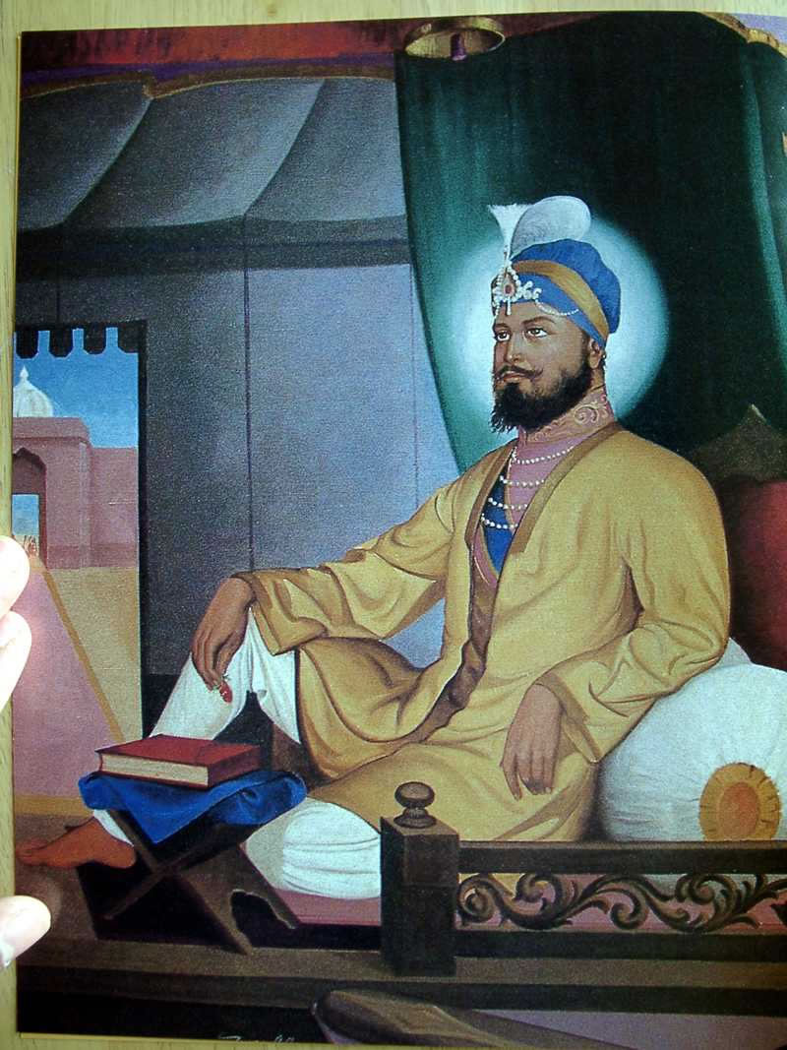
Both these symbols, bottom dot and adhik, are essential if proper sounds of the Persian words are to be pronounced.
These symbols have been extensively used by Guru Gobind Singh in his hymns, particularly Jaap Sahib.
Gurbani hymns in the Guru Granth Sahib also contain Persian words.
However, adhik or foot dots have not been used there, since these symbols had not evolved until then.
Combining the two kinds of hymns in the same volume would obviously cause confusion regarding their pronunciation and their meaning

Slide 4

This can be explained by giving examples from the English language.
There are two different spellings of the same word in Canada and America.
The word ‘honor’ in Canadian (and British) English is spelled as ‘honor’ in the American dictionary.
There are many such words having different spellings in Canadian and American English.
For one word, we always use only one spelling in a book.
Two different spellings of the same word in the same book can confuse and misguide the reader.

Slide 5
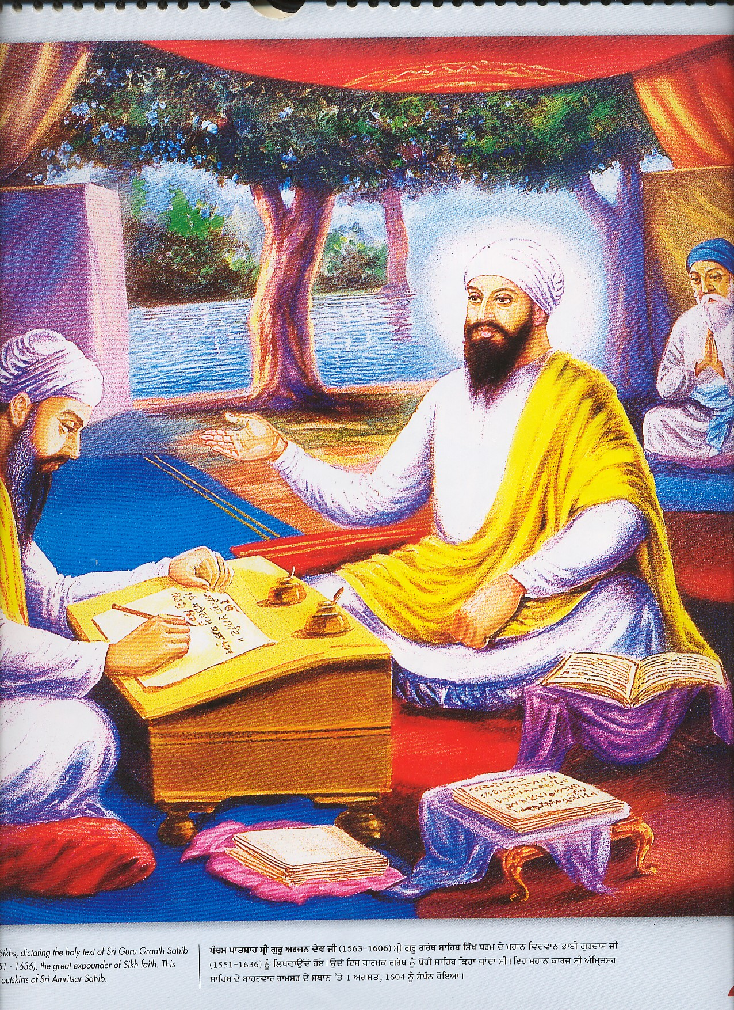
In the same way, two different spellings of the same word, one used by the tenth Guru and the second by the other Gurus, in one volume could cause confusion to the readers.
Therefore, their hymns have to be kept in separate volumes.

Slide 6
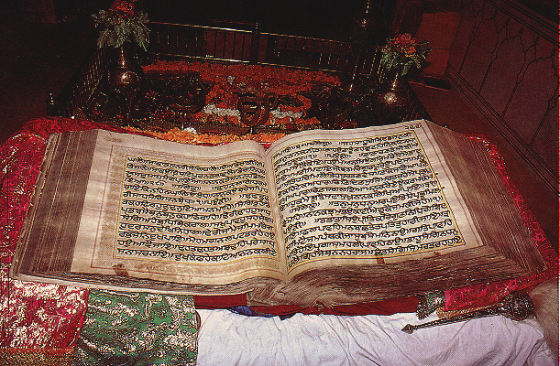
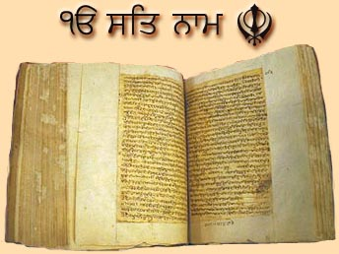
The other reason is the structure of the holy hymns in the two volumes.
Hymns in the Guru Granth Sahib have been arranged according to the Ragas, Musical modes, Akal Ustat, the major contribution of the tenth Guru in the Dasam Granth, is topic (subject) based.
It includes many kinds of musical modes, Chaupai, Chhand, Swayas, etc., to discuss one topic, virtues of Akal, God.
GURU GRANTH SAHIB
DASAM GRANTH

Slide 7
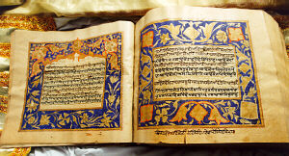
Therefore, Akal Ustat, having many kinds of musical modes, cannot be included under one single Raga in the Guru Granth Sahib.
If Akal Ustat has to be included in the Guru Granth Sahib, it shall have to be split to shift its hymns under their respective musical modes.
Hence, to keep Akal Ustat as it is, it had to be in a separate volume.

